Slide 1

SmartBid Auction Platform
March1, 2025
Kailong duan, Anushka Chaudhari, Manuel Garcia
WOW (Every Saturday/5pm,Zoom)
Notes:
September 2010
1

Slide 2



Team Profile Page
Kailong Duan
Henan, China
Project Management
Graduate Student in CS
Worked as software engineer for 3 years.
Anushka Arvind Chaudhari
Project Management
Graduate Student in CS
Participated In Various Technical College events during undergrad
Manuel Garcia
Irving, TX
CS Undergrad Commercial Real Estate Broker for over 4 years
Notes:
Individual Picture of each member
Hometown (city, state)
Primary focus area or desired focus area
Current internship position or job position (company is not needed)
One interesting fun fact about the person

Slide 3
SmartBid Auction
Project Status is Yellow
Criteria to Green resolve resource challenge
Summary Project Status Financial Status
SmartBid is developing a secure, web-based auction platform that facilitates
transparent buying and selling of products through real-time bidding.
Key features include secure user authentication, detailed buyer
and seller profiles, auction listing and management tools, and a live bidding system with
instant notifications.The platform will support secure transactions through
a payment gateway and escrow system, offer comprehensive transaction history tracking,
and include a rating and review system. An admin dashboard
will enable management of users, listings, and fraud detection for overall platform integrity.
We are currently at the halfway point of the project timeline, with 58% of the work completed. This includes requirements, arch design, test case, and front-end development. The remaining tasks are progressing steadily. The team is stable and collaborating effectively. We have several risks but we have the confidence to resolve them.
Contract Price: $ 2.7M
Cost (Baselined):2M
Actual Spend: $ 2M
ETC: 1.8
EAC: 500k
Current Margin ￥546,517
Key Achievements
Planned Activities
Risks
Major Milestones
Completed SOW – 3/3/25
Completed Stakeholder – 3/5/25
Completed Req Specification – 3/10/25
Completed Site Map – 3/4/25
Completed Wireframes- 3/6/25
Complete High Level Design of Arch –3/28/25
Complete the Arch Design for both FE BE -7/10/25
Arch Infrastructure & BOM - 4/21/25
Dev Implement logging and Code review and bug fix -6/18/26
Testing from Developers- 7/30/26
Testing Execution –03/24/2025
Product Release and preparation of the collection and gather analysis 03/12/2026
Deploy project –03/13/2026
SOW Signed 3/3/25
Create Final Stakeholder template(3/5/25)
FE Req Document(3/1O/25
BE Req Document(3/1O/25)
Sign-off on final Wireframe doc(6/24/25
Complete high-level arch design –3/28/25
Complete detailed arch design –-7/10/25
Complete Infra & BOM Plan –2/9/27
HW/SW ordered and received –Infrastructure set up – 1/20/27
Dev & test environment set up – 6/19/25
Complete Test Cases – 1/11/27
Complete coding – 7/29/26
Code is ready for testing –7/30/26
Complete UAT -9/25/2026
Complete Integration Testing – 3/3/27
Deployed solution approved –Complete deploy project – 5/7/27
Task 295 UAT test execution with users might be late because the client is uncertain about the UAT schedule. This could delay the start of Task 296 Defecting Fixing from UAT
Task 385, The purchase of software and hardware will be delayed because NVIDIA's latest GPUs are in extremely high demand and are very difficult to obtain. This may affect the Tasks 386 and test process of the entire AI bidding system.
Notes:
4/27/20252011-10-19
3
CRICKET_HOUSTON_CDMA_LTE_MEETING
3
3
CDMA_LTE_STEERING_MEETING
2012-06-13

Slide 4
Cost Comparison Slide Summary
Top-Down Cost
Req : $100,000.00
Arch : $430,000.00
Code $600,000.00
Test: $400,000.00
Deploy:$400,000.00
PM : $ 60,000
Total Cost: $1,930,000.00
Margin: $482,500.00
Price $2,412,500.00
Bottom-up Cost
Req: $$125,400.00
Arch : $418,888
Code: $717,120.00
Test: $460,040.00
Deploy:$401,960.00
PM : $ 63,200
Total Cost: $2,186,068.00
Margin:25% $546,517
Price: $2,732,585.00
Variance
Our Bottom-Up (BU) cost comes out to be $320,085, which is a 13% increase when compared to the Top-Down (TU) cost. mainly due to the coding phase, which took more time and resources than expected. We need better planning or parallel multitasking to accelerate the progress.

Slide 5
Major Milestones
Critical Path / Key Milestones
Milestone | Status | % Done | Start Date | End Date | Comments
SOW Signed | C | 100% | 3/3/25 | 3/3/25
Create Final Stakeholder Template | C | 100% | 7/14/25 | 7/14/25
FE Req Document | C | 100% | 3/3/25 | 9/19/25
BE Req Document | C | 100% | 8/8/25 | 9/19/25
Final Wireframe Doc | C | 100% | 9/8/25 | 10/28/25
Final App Map | C | 100% | 3/3/25 | 3/6/25
Notes:
Status is Blue for Complete, Red for in trouble, Yellow for almost in trouble, Green for no challenges
Color of box should be shaded to Blue, Red, Yellow, or Green, Letter in box should be C for complete in the Blue box, the others are RYG.
%Done should reflect the project schedule % complete and must contain the percent sign.

Slide 6
Major Milestones
Critical Path / Key Milestones
Milestone | Status | % Done | Start Date | End Date | Comments
Complete Coding | Y | 75% | 03/04/2025 | 06/18/2026 | The backend code is taking more time than expected due to the complexity of the functionalities. There may be a risk of delays.
Code is ready for testing | G | 0% | 06/19/2025 | 07/30/2026 | The frontend part of the code is basically complete, while some functionalities in the backend still require time to be implemented.
Complete Integration Testing | Y | 28% | 03/24/2025 | 03/03/2027 | Currently, only some features and pages have been tested. The remaining parts are still waiting for the code to be completed and deployed before testing can begin.
Complete UAT | Y | 0% | 08/24/2026 | 09/25/2026
Deployed solution approved | G | 0% | 05/05/2027 | 05/05/2027
Complete deploy project | G | 0% | 05/07/2027 | 05/11/2027
Notes:
Status is Blue for Complete, Red for in trouble, Yellow for almost in trouble, Green for no challenges
Color of box should be shaded to Blue, Red, Yellow, or Green, Letter in box should be C for complete in the Blue box, the others are RYG.
%Done should reflect the project schedule % complete and must contain the percent sign.

Slide 7
Project Key Risks
# | Risk | Mitigation | Contingency | Owner | Due Date | Comments
1 | .Task 362 Purchase hardware and software may be delayed due to procurement issues impacting task 363 CPU, GPU, Memory, Server, Network, Ram Ins | Initiate hardware & software purchase at project kick-off or during early planning stages | Use cloud infrastructure (AWS, Azure, GCP) to begin setup until physical hardware arrives | Anushka | 4/19/25
2 | Task 379 Review Deploy Plan with Client may be delayed due to Misunderstanding or scope mismatch impacting task 381 Infrastructure setup | Involve the client in preliminary planning stages to align expectations early. | Schedule an additional meeting or follow-up session with the client to discuss any remaining questions or adjustments. | Anushka | 5/28/25

Slide 8
Project Key Risks
# | Risk | Mitigation | Contingency | Owner | Due Date | Comments
3 | Task 110 Creating The Architecture For Federal Compliance: HIPPA, FDA, PHI. Agencies may require much more intricate solutions | Ensure all engineers on the project are well informed and provided with detailed specifics of what is required by agencies | Create Architecture ahead of schedule to allow ample time for review. | Manny | Oct 7 | Adhering to agencies will always have its intricacies and challenges.
4 | Task 104 Creating API architecture. Vendors may require that API’s to access our service adhere to their standard which may significantly vary from company to company. | Communicate the importance of reviewing all requirements. Every Architecture section has a dedicated review date to ensure no requirements are forgotten nor looked over | Have Arch leads review the API’s and assess that all requirements are made before delivering to the development team. | Manny | Nov 4 | Given multiple vendors will use our platform we need to ensure their data and ours is accessible via well engineered API with all the proper security features and functionality.

Slide 9
Project Key Risks
# | Risk | Mitigation | Contingency | Owner | Due Date | Comments
5. | Task 206 - ​Complex Authentication System: Implementing secure user authentication with proper verification processes may take longer than anticipated. It includes Identification, Credential Verification, Access Control, Session Management, etc. The code complexity is relatively high, which may lead to delays. | M1:Use ​pre-built auth solutions (Firebase Auth, Auth0) to speed up development. M2: Implement ​modular verification steps (email → phone → document upload). | 1. If verification takes too long, ​launch with basic email auth first and add advanced verification in Phase2 2.Assign more developers to participate in this project. | Kailong duan | March 4th
6. | Task 173- When users upload high-resolution images of medical supplies, they often experience painfully slow upload speeds that get stuck halfway. If multiple users upload images simultaneously, it can easily overwhelm the server. Add unstable mobile connections into the mix, and you get frequent upload failures halfway through - it seriously ruins the user experience. | M1:We'll use AWS S3 with CloudFront CDN to turbocharge image delivery. medical supply photos get stored in Amazon's secure cloud. CloudFront automatically distributes them to servers worldwide. Users always download from the nearest location M2: Built-in image optimization (auto-format conversion, sizing). Scales instantly during traffic spikes | 1.If uploads fail, provide ​manual upload via email as a temporary workaround. 2. can call customer service to help customers upload pictures | Kailong duan | May 6th

Slide 10
Project Key Risks
# | Risk | Mitigation | Contingency | Owner | Due Date | Comments
7 | Task294-we need define auction testing scenarios. There may not be enough defined scenarios and insufficient coverage. | M1:​ Develop and provide code coverage reports (≥80% required),Include as many test scenarios and test cases as possible M2: Use AI to generate supplementary test cases (such as Postman Automation), normalize and scale to include almost all test scenarios. | 1. Implement gradual feature rollout (canary release) with real-user behavior monitoring for post-launch testing and add it to the testing environment. 2. ​ Ensure that most test scenarios can be tested if time is insufficient. | Kailong duan | August 31st
8 | Task 253 - The test environment is unstable or crashes due to environment configuration errors or data contamination. | M1: Add containerized test environment with advanced environment configuration technology (Docker+K8s one-click reset) M2: Add the automatic rollback function. Add triggers automatic rollback immediately after an environment crash (based on previous day's environment backup) | 1. Allow direct testing of pre-production environments during emergency repair 2. Provide local testing sandbox to developers for emergency use. | Kailong duan | August 10th

Slide 11
Project Key Risks-updated
# | Risk | Mitigation | Contingency | Owner | Due Date | Comments
7 |  |  |  | Kailong duan | August 31st
8 |  |  | . | Kailong duan | August 10th

Slide 12
Project Key Actions
# | Description | Originator (Student Name) | Owner | Date Assigned | Date Needed | Date Closed | Comments
A1 | Conduct a security survey with the backend team to verify that user authentication and role-based access control meet McKesson standards | Anushka | PM | 2/27/25 | 3/4/25
A2 | Setup up frequent meetings with the Customer during the Database system Architecture phase reducing the chance of any changes, | Anushka | PM | 2/25/25 | 3/1/25
A3 | Held meetings with the company's algorithm development engineers to define the optimization and testing deployment of the AI-based Bidding System's large model. | Development Lead | Kailong Duan | 5/23/2025 | 6/1/2025 |  | All algorithm engineers attended the meeting to finalize the optimization and deployment plan for the large model.
A4 | Regarding UAT testing, arrange meetings between the test team and customers to discuss the design of test examples and user test scenarios. | Test Lead | Kailong Duan | 8/24/2026 | 8/30/2026 |  | The PM needs to ensure that the test scenarios and test cases meet the customer's daily usage needs.
A5
A6

Slide 13
Project Key Actions-updated
# | Description | Originator (Student Name) | Owner | Date Assigned | Date Needed | Date Closed | Comments
A1
A2
A3
A4
A5
A6

Slide 14
Project Decisions
# | Description | Owner (Student Name) | Decision Date | Comments
D-1 | Development team with use a microservices architecture for the backend to support scalability | Anushka | March 2 | Agreed upon during the Architecture Design Review . Attendees were Architecture Leads, Development Leads and Testing Leads
D-2 | Security features will include multi-factor authentication to align with McKesson security designs . | Anushka | Oct 15 | Agreed upon during Security Requirements Review . Attendees were Development Leads and Architecture leads
D-3 | Outsourced the Integration Testing to an external vendor. The vendor charged $30,000, helping the company save $20,100. | kailong duan | Aug 28 | Agreed Upon During Weekly Client VP meeting Attendees were CEO, CTO, CFO,VPs, managers, Client VPs and Team Leads
D-4 | Approve the purchase of a large number of NVIDIA GPUs and CPUs for training the next-generation AI-based Bidding System. | kailong duan | Aug 22 | Agreed upon during Technical Meeting on April 1th . Attendees were CTO, VP, PM,CFO,COO, PM, Testing Lead.

Slide 15
Project Decisions-updated
# | Description | Owner (Student Name) | Decision Date | Comments
D-1
D-2
D-3
D-4

Slide 16
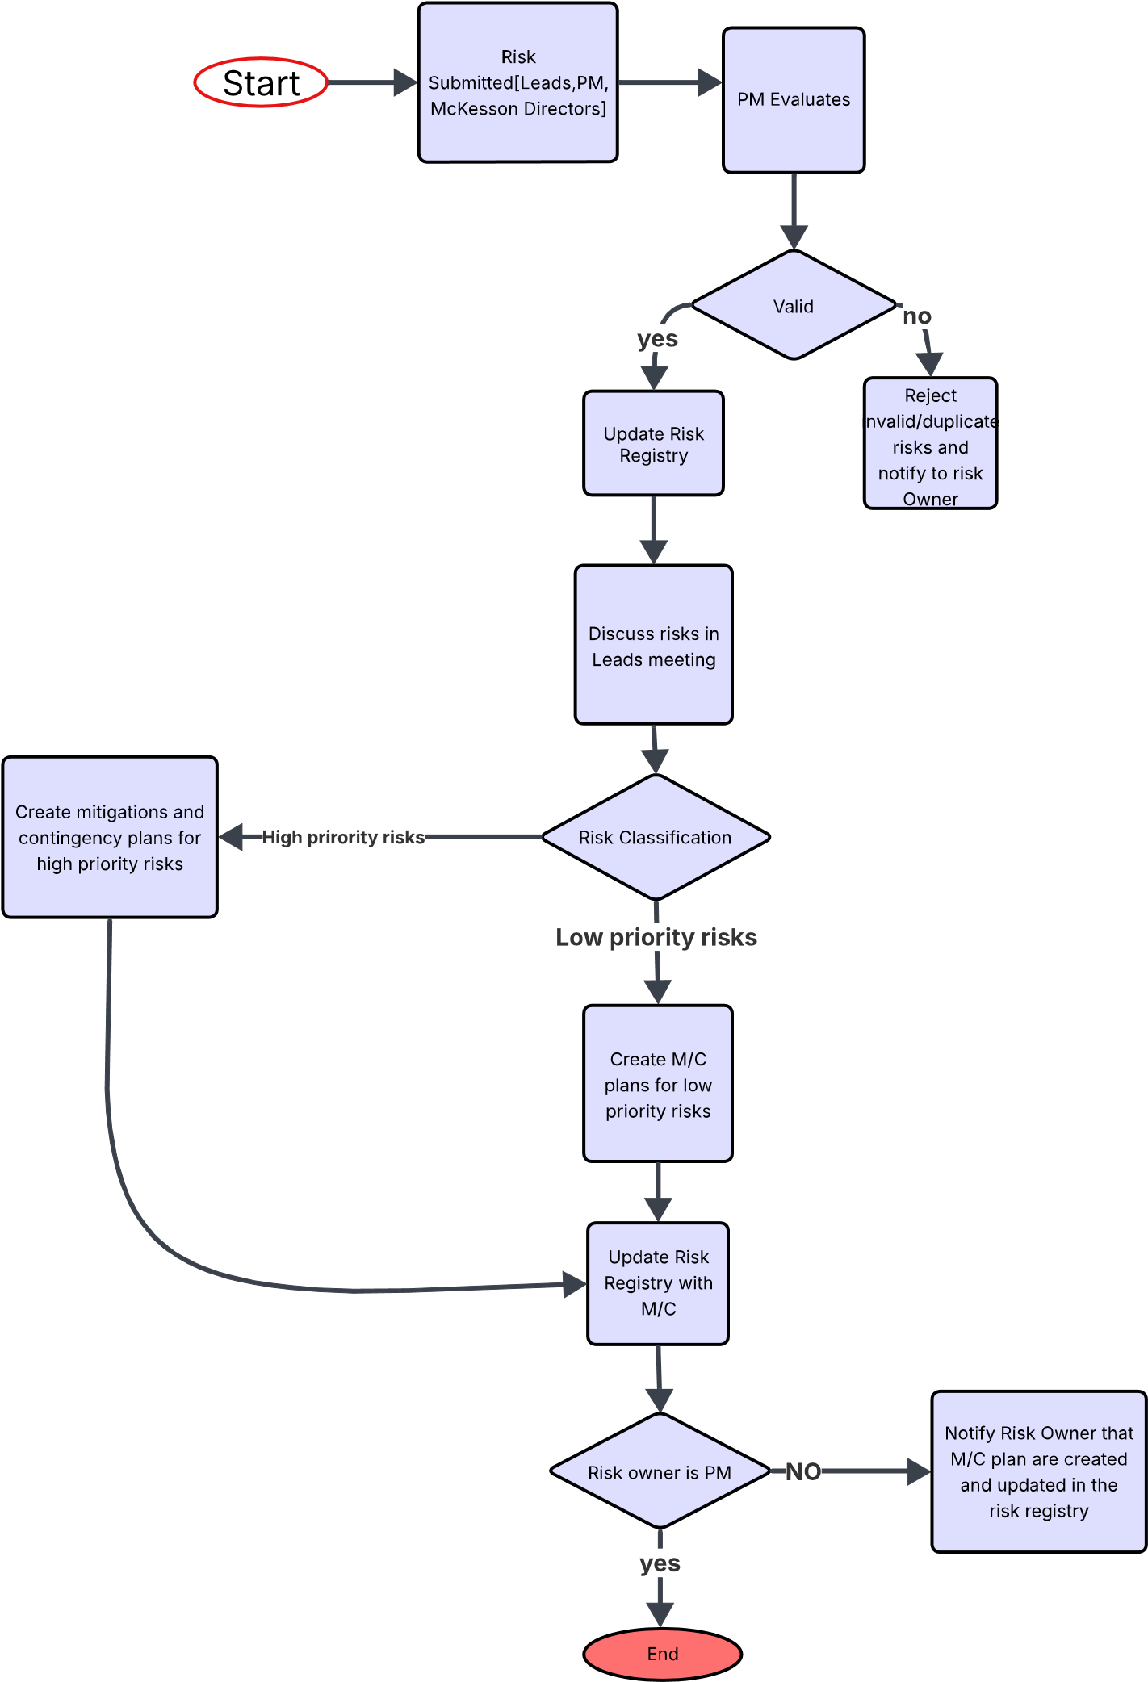
RISK Management Chart

Slide 17
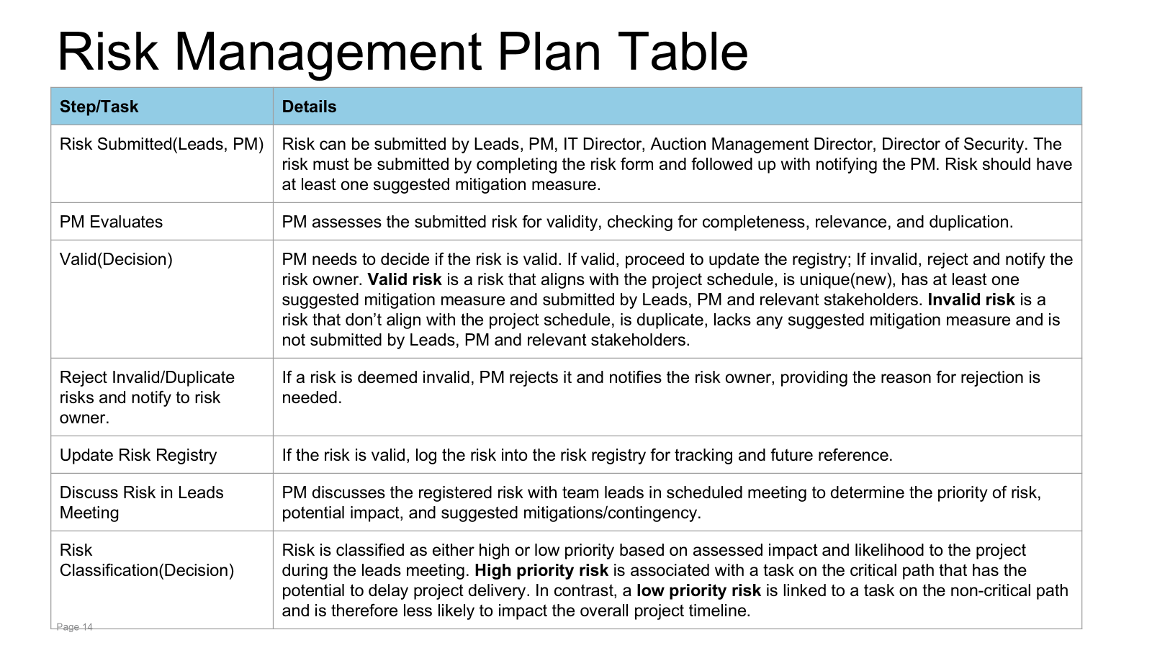

Slide 18
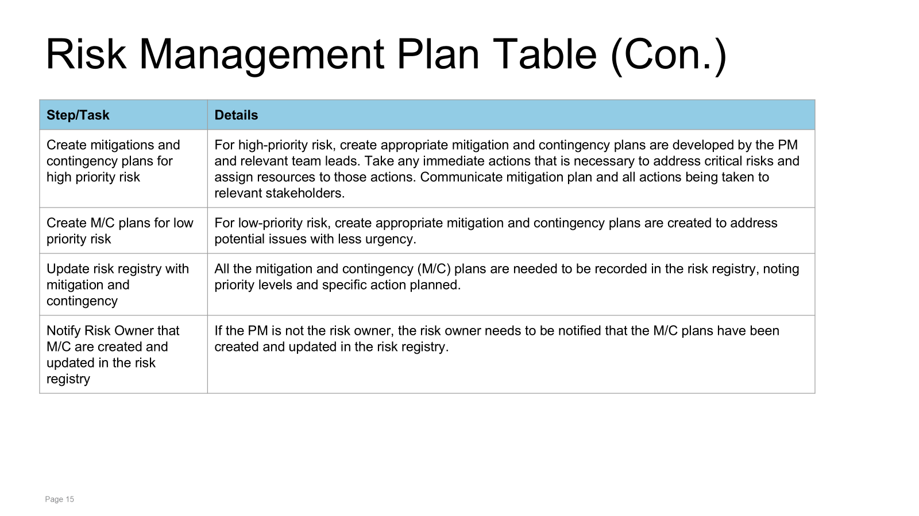

Slide 19
Meeting Minutes (Assignment 3)
Group Number: 10 |  | Project Name: Library Book Sorting
Project Manager (s): Annie R.
Meeting Date | Attendees | Absent | Topic Discussed / Work Assigned
5-April | Manny , Kailong , Anushka | None | TOPIC Discussed: Went through previous Schedule Feedback Discussion Improvements Project 3 overview Next meeting Work Assigned : Anushka : Requirement Schedule fix Kailong : Deploy ,test ,dev Schedule fix Manny : Archi fix Everyone : Work On the Project Schedule
12- April | Manny , Kailong , Anushka | None | Topic Discussed : Schedule [Laddering , Progression] Risk Management Flow chart Risk Management Table Work Assigned: Risk Management Diagram, table : Anushka Major Milestones : All Everyone : Work On Schedule Next meet : 13 - April

Slide 20
Meeting Minutes (Assignment 3)
Group Number: 10 |  | Project Name: Library Book Sorting
Project Manager (s): Annie R.
Meeting Date | Attendees | Absent | Topic Discussed / Work Assigned
13-April | Manny , Kailong , Anushka | None | TOPIC Discussed: Project Overview MPP Done Risks Discuss Work on PPT Work Assigned : Everyone work on PPT

Slide 21
Who Delivered What Assignment 3?
Group Number: 10
Assignment | Deliverable
1 | Profile Page Input – All SOW Ideas – All SOW Slide – Anushka Cost Slide-Manny
2 | RAID Everyone SOW - everyone MPP:- everyone Anushka : Req Manny : Archi Kailong : Coding , testing , deployment

Slide 22
Project Name
Project Dashboard Template
March1, 2025
Kailong duan, Anushka Chaudhari, Manuel Garcia
WOW (Every Saturday/5pm,Zoom)
Notes:
September 2010
22

Slide 23
Team Profile Page
Kailong Duan
Henan, China
Project Management
Graduate Student in CS
Worked as software engineer for 3 years.
Anushka Arvind Chaudhari
Project Management
Graduate Student in CS
Participated In Various Technical College events during undergrad
Manuel Garcia
Irving, TX
CS Undergrad Commercial Real Estate Broker for over 4 years
Notes:
Individual Picture of each member
Hometown (city, state)
Primary focus area or desired focus area
Current internship position or job position (company is not needed)
One interesting fun fact about the person

Slide 24
SmartBid Auction Platform
Project Status is Yellow
Criteria to Green resolve resource challenge
Summary Project Status Financial Status
SmartBid Auction Platform is an advanced bidding system designed to optimize online auctions, particularly for businesses and procurement processes. It uses AI-powered automation, real-time analytics, and competitive bidding strategies to enhance efficiency and transparency
Project has started gathering requirements for the stakeholder template after getting the SOW signed. Team is in a good spirit to start the next tasks.
Contract Price: $ 1.5M
Cost (Baselined): $800k
Actual Spend: $ $ 13,440
ETC: $ $535,360.00
EAC: $ $548,800
Current Margin: 63.25%
Key Achievements
Planned Activities
Risks
Major Milestones
•Completed SOW – Mar 3
•Completed documenting stakeholders objectives – Mar 6
•Finalize stakeholder template - Mar 7
•Start gathering frontend requirements - Mar 8
Task No. 35 – Payment Processing Might be delayed due to integration issues with third-party payment gateways, which could impact the start of Task No. 37 – Secure Escrow System
M1: Select a payment gateway with strong API support and conduct early integration testing.
M2 :Implement a sandbox environment for testing transactions before live deployment.
•SOW Signed
•Complete requirements specification document - Mar 11
•Complete coding- July 23
•Code ready for testing- July 24
•Complete Testing -Aug 27
deploy -Aug 29
Notes:
3/4/20252011-10-19
24
CRICKET_HOUSTON_CDMA_LTE_MEETING
24
24
CDMA_LTE_STEERING_MEETING
2012-06-13

Slide 25
Governance Plan Overview
The governance plan for the Smart Bid Auction project is designed to encourage close collaboration between the Technical leadership Team and Stakeholders, which ensures technical progress is closely tied with user needs and risk management. Stakeholders will actively contribute by giving feedback on functionality and user experience by meeting with Leads on regular basis. The senior leadership stakeholders will participate in key recurring meetings to ensure the project stays aligned with strategic goals and approve major decisions.
➔What are the challenges?
While this plan involves a balanced approach between technical details and Stakeholders feedback and strategic oversight, potential challenges such as coordinating feedback from different groups without delaying development could arise. Additionally, getting busy senior leaders to adhere to regular meeting schedules may also be difficult.

Slide 26
Governance Plan Table
Governance Type | Day / Time | Purpose | Input | Output | Attendees (Owner)
Weekly Internal Status Meeting | M/W 9am-10am | Review schedule, RAID (Risks, Assumptions, Issues, Dependencies), resource allocation, financials | Project Plan, RAID Log, Change Request (CR) Log, Current Status, Dashboard | Updated Project Plan, RAID Log, CR Log, Dashboard | Project Manager (PM), Team Leads, Technical Managers
Weekly External Client Status Meeting | Friday 11:00am-11:30am | Review project progress, address risks, gather feedback | Updated dashboard, RAID log, Client concerns & feedback | Updated RAID log, Action Plan for Client Requests | PM, Client, Project Team Leads
Weekly Internal Technical Meeting | Thursday 11:00am-11:30am | Discuss and resolve technical issues, bug tracking, enhancements | Technical reports, bug reports, system logs | Technical upgrades, bug fixes, development plan | Team Leads, Architecture Leads, Requirement Leads
Weekly Internal Manager/Director Status Meeting | Thursday 3:00 am-4:30am | Review project progress, customer feedback, and resource allocation | Customer feedback, project reports, financial updates | Executive decisions on resource allocation, risk mitigation | PM, VPs, Managers, CFO, COO, CTO
Monthly Internal department meeting | Friday 10:00am-11:00am | Align departmental objectives, handle legal & financial risks | Resource delivery reports, legal & financial risk analysis | Updated RAID, adjusted resource allocation, legal approvals | PM, VPs, CFO, CTO, COO, Chief Legal Officer

Slide 27
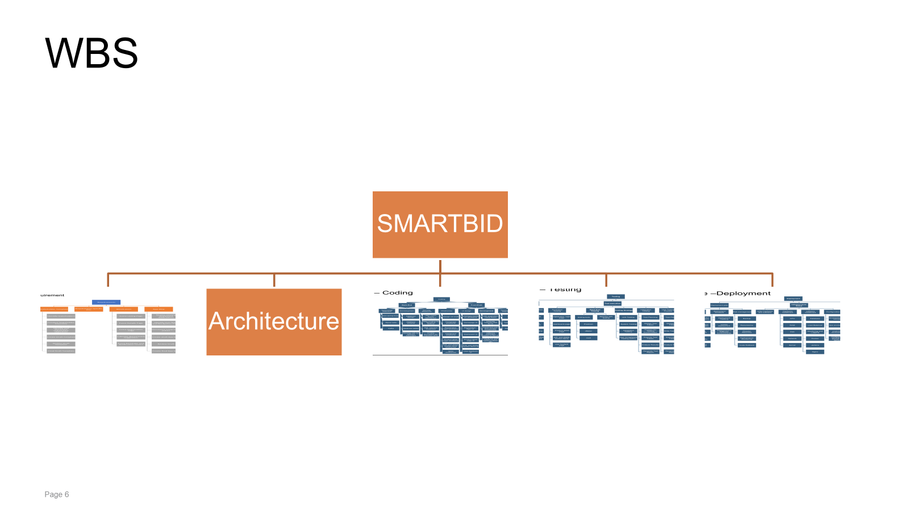
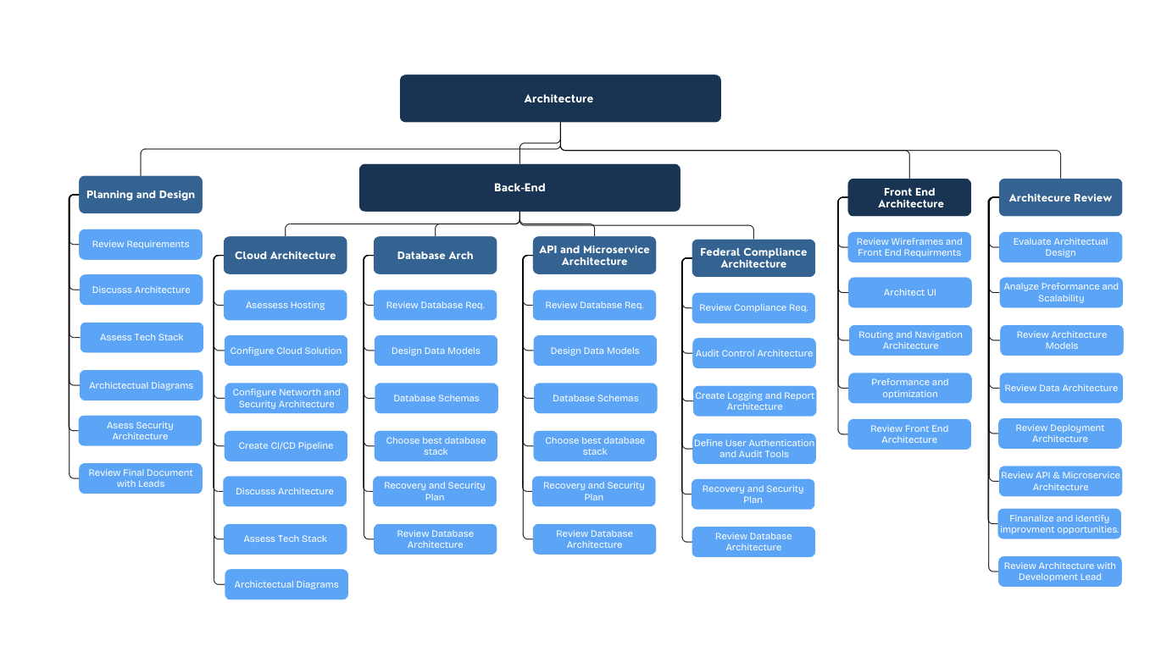

Slide 28
WBS Requirement - updated
Requirements
Stakeholder Template
Identify Stakeholders
Conduct Stakeholder Interview
Identify and document stakeholder objectives
Create Draft Template
Review Draft Template
Final Draft Template
Requirement Specific Doc
Wireframes
App Map
Technical Req
Front end
Backend
Auction Listing Page
Auction Details Page
Auction Registration Page
Bid Management Page
Supplier Verification page
Transaction & Order History Page
Notification & Alerts Page
Review Wireframes with Leads
Update Wireframes
Review Wireframes with client and get signoff
Task Name
Review exisiting dashboard applications
Identify User Roles and Navigation Paths
Document Integration Points
Create a Draft App Map
Review Draft App Map with leads
Update App Map and create final App Map

Slide 29
Technical Req
Frontend
User Authentication
Create Registration Page
Create Login Page
User Profiles
Buyers
Create profile
Track bid
Manage Watchlist
Sellers
List Medical Supplies for auction
Upload Pictures & set starting bids
Define Auction Duration
Auction Listing & Management
Create auction listings with detailed medical supply descriptions, images, and specifications
Set minimum bid amounts and reserve prices
Automated auction closing upon expiry
Real-Time Bidding System
Live bid updates, email, and push notifications
Compliance Verification
Payment Processing
Secure payment gateway with multiple methods (Credit/Debit, Digital Wallets)
Secure escrow system for transaction protection
Transaction & Order History
Rating & Reviews
Admin Dashboard
Manage user accounts, auction listings, transaction reports
Fraud detection and user verification features
Backend Req
Authentication & Authorization
Secure user authentication
Role-based access control (Admin, Buyer, Seller)
Database Management
Relational database to store user profiles, auction listings, bids, transactions, and reviews
Ensure data integrity and normalization
Auction Management System
CRUD operations for auction listings
Automated auction expiration and winner selection
Get signoff from Leads on the technical requirements
Admin Panel Features
Dashboard for monitoring user activity
Fraud detection and account suspension mechanisms
Review technical Req doc with Client and get signoff
WBS REQUIREMENT

Slide 30
WBS Architecture

Slide 31
WBS Slide – Coding-Updated
Coding
Back-End
database design
User, Medical Supplies schema
Medical Supplies, schema
Develop CRUD operations
Security Measures
Front-End
Rating & Reviews, schema
Real-Time Bidding System
Automatic Price Update
email notification
Payment
Add support for various credit card payments
Add PayPal support.
Payment Gateway Integration
payment Confirmation
Payment History
Payment Status Tracking
UI design
Rating & Reviews UI
User Authentication UI
User Profiles UI
Admin Dashboard UI
Edit, and delete auction items UI
User feedback UI
Development
User Profiles
User Login, Register,
Review / Verification
Medical Supplies Auction Settings
Detailed Description
Function List
Image Upload
Price Settings
Auction Time Settings
Payment
redit/Debit Card,
Digital Wallets, paypal
Feedback
Comment
Rating
Customer Support & Complaint Resolution
Dispute Resolution
Admin Dashboard
User Account Mang
Medical Supplies Approval
Generate Medical Supplies Quality
Transaction Report
Transaction Approval
Auction Status Tracking
Proxy Bidding
auction item management
Real-Time Bidding Data
Historical Bidding Records
AI-based Bidding Algorithms
Model selection
Data collection
Data preprocessing
Reinforcement learning
Objective function
Optimize the bidding strategy
Model evaluation
Anti-Cheating System
Rate Limiting
IP and Device Tracking
Behavioral Analysis
Blacklist and User Restrictions
Manual Review System

Slide 32
WBS Slide – Testing-updated
Testing
Test planning
UAT testing
Front-end Testing
User Authentication
registration, login
Payment testing
Feedback
Back-end Testing
User Management Service
Medical Supplies Online Service.
Feedback and Rating Service.
Medical Supplies Product Review and Verification Service.
Real-Time Bidding System Service.
API Integration
other Testing.
Security Testing.
Performance Testing.
Scalability Testing.
Usability Testing.
Test execution
UAT testing
prepare UAT evnironment
define testing scenarios
get feedback from UAT team
sign off and documents
Integration Testing
prepare testing evnironment
add testing Cases
Front-end page Testing
Back-end API Testing
Performance Testing
Test reporting and defect tracking
bug logging
Search for Bug Logs
Classify Bug Logs
Organize Bug Report
Send to Developers for Handling
Bug tracking
Add Bug Report Progress Tracking
Display Report After Handling, Further Testing
Bug Issue Resolution Completed
Determine Test Objects
Define Test Scope
Resource Preparation
Schedule Time
identification Risk and mitigation
AI-based Bidding Algorth Testing
Define experimental
Monitoring indicators:
Add Main indicators
auction success rate
Deploying new algorithms
data analysis
Algorithm update
Test process
Continuous monitoring
Iterative optimization

Slide 33
WBS Slide –Deployment-uploaded
Infrastructure Setup
Deployment
deployment target/ requirement
deployment schedule
weekly deployment
Risk management
Backup
Connect to the code repository
Pull the latest code changes
Build the application
Verify functionality
Deploy the application
deployment meeting
Deployment in Different Environments
Redundancy
Disaster Recovery
Performance Monitoring
Code Rollback
Deployment plan
order hardware and software
Hardware installment
CPU
RAM
Disk
Network
Server
software installment
Database
Load Balancer
Monitoring and Logging
Docker
Jenkins
Nginx
Configuration
development environment
test environment
production environment
configure the network and firewall and security
deployment Solution
deployment tools
Jenkins
Kubernetes
Helm
product released
release process
release management
Validate Feedback collection
gather and analysis
AI-based Bidding Deploy
Model Export
Inference Service
Monitoring & Optimization
Version Control
Continuous Updates (CI/CD)

Slide 34
Cost Comparison Slide Summary
Top-Down Cost
Req : $ 100,000.00
Arch : $120,000
Code $30,000.00
Test: $10,000.00
Deploy:$20,000.00
PM : $63,200.00
Total Cost: $349,200.00
Margin: $69,840.00
Price $419,040.00
Bottom-up Cost
Req: $ 129,960.00
Arch : $243,800
Code: $320,800.00
Test: $137,920.00
Deploy:$490,400.00
PM : $63,200.00
Total Cost: $1,322,880.00
Margin: $237,992.000
Price: $1,427,952.00
Variance
Our Bottom-Up (BU) cost comes out to be $1,264,387, which is a 63% increase when compared to the Top-Down (TU) cost. The price difference between BU and TU shows a significant underestimation of resources and duration in the TU estimation. Major cost differences were observed across all project phases, with coding costs rising by 147%, testing costs increasing by $103,027, and project management costs nearly tripling to $316,800.The duration for each phase has doubled or more than doubled.Each phase has increased resources by 15%.Many review tasks (PM tasks) were included in BU, which were not part of TU estimation.More comprehensive testing phases were needed, leading to increased time and cost.Higher complexity in architecture design led to greater effort estimates.

Slide 35
Cost Comparison Slide Requirements
Top-Down Cost
$100,000.00
Bottom-up Cost
$129,960.00
What changed in the Bottom-Up Estimate ?
High total effort and extended duration: The BU factors In real durations that extend beyond what was estimated for the TU. For example in TU, backend requirements was estimated to take 10 days where as in the BU is it estimated to take 56 days which is more than double. Because of the extended duration and more efforts from resources the cost for the BU is high.
More resources utilized: The BU estimate includes more Requirement Engineers(7) working in parallel or together sometimes depending on the tasks. The BU has more time-intensive tasks than the TU and allocates more time to do requirements review.
Detailed task breakdown: The BU estimate comes from a more granular breakdown of tasks. Instead of just high-level categories, each task is broken down into more detailed requirement gathering and reviews tasks. Because of the breakdown of tasks, the BU reflects the true work involved.
What is real for the BU ?
The BU involves Stakeholder Template, Wireframes and App Map Requirements gathering that will add more time when compared to the TU.
The BU estimates 88 days for Technical requirements gathering which is more than double of what TU estimates(19 days)
The BU total days comes up to be 102 days which is significantly bigger than the original TU estimate which is 29 days.
The cost differences between the Top-Down (TD) estimate, which was set at $ 100,000.00
shows a significant underestimation when compared to the Bottom-Up (BU) estimate
, which amounts to $ 129,960.00
Assumption for the Top-Down Estimate
Simplified Resource utilization assumption The TD estimate assumes that two Requirements
Engineers working with a Requirement Lead suffices for the project. In addition the TD allocates
less time to review requirements and focuses more on gathering requirements.
Simplified task breakdown: The TD estimate focused on major categories(Tech Stack, Frontend
, Backend) without taking accounting for the granularity of the actual tasks required under
each category.

Slide 36
Cost Comparison Slide - Architecture
Top-Down Cost
$120,000
Bottom-up Cost
$243,000.00
Variance
What were some of the big changes. Duration, hourly cost, etc
Roles not accounted for
Regulations we need to adhere to given we are making software for a medical company
Additional requirements
The cost differences between the Top-Down (TD) estimate, which was set at $169,200,
shows a significant underestimation when compared to the Bottom-Up (BU) estimate
, which amounts to $243,000.000
Assumption for the Top-Down Estimate
Simplified Resource utilization assumption The TD estimate assumes that 2 architecture engineers. a lead and a PM. We did not consider the cloud solutions, database intricacies, and overall sheer volume of work required. When broken down into steps and researched further we discovered various agencies which have requirements of their own for medical software.
Simplified task breakdown: The TD estimate focused on major categories(Tech Stack, Frontend
, Backend) without taking accounting for the granularity of the actual tasks required under
each category.

Slide 37
Cost Comparison Slide – Coding-Kailong Duan
Top-Down Cost
Based on the SOW, the Development total estimate cost is $300,000, with the following breakdown for each deliverable:
Front-end part: 30%, $90,000,
Back-end part: 70%, $21,000
Bottom-up Cost
Based on the MPP, the total coding cost is $320，800, with the following breakdown for same deliverable:
Front-end part: 20%, $63,840,
Back-end part: 80%, $256,960
Variance
The total cost exceeds the estimate by $20,800
The main cost difference is that for The backend has more functional requirements, leading to increased time and cost.
.

Slide 38
Cost Comparison Slide –Testing-Kailong Duan
Top-Down Cost
Based on the SOW, the Development total estimate cost is $100,000, with the following breakdown for each deliverable:
Testing plan:5%, 5,000
UAT Testing:20% 20,000
Other test: 15%, $15,000
Test execution: 20% $20,000
Al-bidding test:10%,10,000
Testing reporting: 30%,30,000
Bottom-up Cost
Based on the MPP, the total coding cost is $137，920, with the following breakdown for same deliverable:
Testing plan:3%, 4,800
UAT Testing:25% 35,200
Other test: 8%, $11,200
Test execution: 20% $27,520
Al-bidding test:14%,18,880
Testing reporting: 30%,40,320
Variance
The total cost exceeds the estimate by $37,920
The main cost difference is that UAT testing and Testing execution, The UAT testing scope exceeded initial expectations, resulting in higher-than-anticipated time expenditures.
Integration testing was incorporated during the testing execution phase, leading to increased operational costs.

Slide 39
Cost Comparison Slide – Deployment Kailong Duan
Top-Down Cost
Based on the SOW, the Development total estimate cost is $300,000, with the following breakdown for each deliverable:
Deploy plan:10%, 30,000
Infras Setup:15%, 45,000
Configuration: 10%, $30,000
AI-based Bidding deploy: 15%,45,000
Deploy Solution:50% 188,400
Bottom-up Cost
Based on the MPP, the total coding cost is $347,600 with the following breakdown for same deliverable:
Deploy plan:7%, 24,800
Infras Setup:13%, 46,400
Configuration: 11%, $40,000
AI-based Bidding deploy: 14%,48,000
Deploy Solution:55% 188,400
Variance
The total cost exceeds the estimate by $47,600
The main cost difference is Deploy Solution, During the Gather and Analysis phase, Business Impact Analysis and Continuous Improvement processes were implemented to enhance project control, resulting in additional cost expenditures

